Slide 1

Unlocking Excellence
Exploring Our Data Science Capabilities
Private & Confidential

Slide 2


Flairminds - Who we are?
A youthful company, ablaze with potential and promise
2022
Our company's base is situated in the Cloud and…
350% Yoy
(65 people strong)
The deeper you rooted, the faster you grow
We date, but we believe in marriages
(average customer retention rate)
87%
We are as good as our People
(average associate retention rate)
96.2%
Private & Confidential

Slide 3
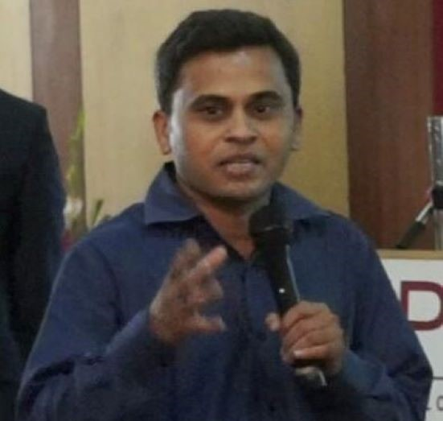





Driving our Engagement Success - Leadership
Hasmukh Parekh
Director, Strategy
Shriman Tiwari
Chief Data Scientist
Sameer Awate
Chief Technical Officer
Gaurav Kohli
Technical Architect- AWS
IIT Kanpur
Reliance
IIT Kanpur
Retail - GCP
Exp: 15+
JAVA
Exp 15+
AWS
Private & Confidential

Slide 4










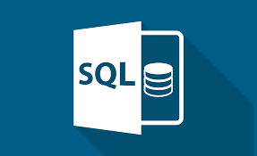




Delivery Organization
DevOps
Full Stack
Data Science
MSDB
DevOps Engineers
Full Stack Engineers
Data Engineers
Software Engineers
Security Engineers
BackEnd Engineers
Machine Learning Engineers
Software Test Engineers
UX Designers
Data Analysts
Software Developers
Data Scientists
Technology Architects
15+
20+
18+
15+
Private & Confidential

Slide 5
Why FlairMinds ?

Slide 6
Why FlairMinds ? we help you solve these challenges
Challenges in Current Marketplace Situation
Limited Visibility into Operations
Inefficient Use of Resources
Poor Decision-Making
Missing Trends and Business Patterns
Increased Business & Compliance Risk
Siloed and Stale Data
Ability to Adapt
Competitive Disadvantage
Unoptimized Talent
Private & Confidential

Slide 7
Transforming Businesses with Data-Driven Insights
- Past Successes
Increase in sales volume for Global spirits manufacturer based in France
10%
No of claims analysed on daily basis across top 100 insurance carriers across the globe
1 MM+
Increase in promotion sales for a European Retailer
3%
Accuracy on matched products analysis for an eCommerce company
94%
Private & Confidential

Slide 8




















Data / Technology ecosystem at Flairminds
STORAGE
ANALYSIS
MODEL
VISUALISE
PLATFORMS & DEVOPS
Private & Confidential

Slide 9
Technologies at Flairminds
Methodology | Description | Tools capability @ Flairminds
Machine learning | Read hidden patterns to learn and improvise the system | Scikit_learn, ML algorithms such as - Linear regression, KNN, Random forest, SVM, XGboost etc
Predictive analysis and visualization | Identify the likelihood of future outcomes based on historical data | ML algorithms, Azure ML. Data studio, Power BI, Tableau, Seaborn
Natural language processing | Analysis and synthesis of natural language and speech which makes human language decipherable to computer | Spacy, NLTK, Gensim, TF-IDF, Word2vec, Word2doc, Bert, FAISS
Object detection and image processing | Sorting image objects by detection, tracking and classification using computer vision | TensorFlow, Transformer, Pyspark, FAISS, OpenCV
Deep learning | A neural network that attempts to simulate human brain | Pytorch, TensorFlow, Theano, Pyspark, FAISS, OpenCV, Transformer
Big data analytics | Uncover trends, patterns and correlations in large amount of raw data | MongoDB, Azure, Google cloud, AWS, Apache spark, Tableau
Cloud services | Cloud architecture for model deployment and APIs | Azure, AWS, Google Cloud
Private & Confidential

Slide 10

People Competencies at Flairminds
Systems Architect
Cloud Architect
Web Developer
Technology Developer
Program Management
Quality Executives
Data Scientist
Data Analyst
Data Engineer
Business Analyst
Process Analyst
Consulting Leads
Project Manager
Private & Confidential

Slide 11
Unleashing the Power of Data
How Data Science Transforms Business Functions
Customer
Distribution
Product
Pricing
Customer profiling
Customer segmentation
Acquisition Strategy
Next best action
Retention, Renewal, Lapse prediction
Customer Experience
Performance
Supplier analytics and Segmentation
Sales Lead
Pipeline Forecasting
Producer Retention
Web Journey / Omnichannel Effectiveness
Channel Optimization
New Product Development
Portfolio Management
Underwriting Risk Selection
Product Analysis
Loss Control
Optimising Underwriting Cycle
Automated Rules Engine
Market and Competitive Research
Exposure / Policy level Pricing
Segmentation
Real Time Price Optimization
Pricing Elasticity
Competitive Pricing
Private & Confidential

Slide 12
Data Science Services
Retail
Finance
Healthcare
Energy
Auto-pricing
Pricing optimization
Product matching
Marketing campaigns optimization
Product promotion optimization
Product replenishment optimization
Customer profiling
Customer segmentation
Predicting inventory
Similar products
Recommendation engines
Algorithmic trading
Making investment predictions
Fraud detection and prevention
Portfolio management
Loan underwriting
Process automation
Customer data management
Decision-making
Customer service level Improvement (Chat bots)
Personalized medicine
Detecting fraud in healthcare claims
Identifying diseases and Diagnosis
Medical imaging diagnosis
Machine learning-based behavioral modification
Smart health records
Clinical trial and research
Predictive maintenance
Grid management
Demand and load forecasting
Reduced energy consumption
Reliable renewable energy forecasts
Energy source exploration
Optimize prices through better trading
Private & Confidential

Slide 13



Approach at FlairMinds
The data science projects are agile by definition and with an iterative logic It would be necessary to do multiple iterations before having a final working model for industrialisation
>
Creation of variable
Preliminary analysis
Model selection
Comparison of algorithms
Business integration
Data
Preparation
Modelisation
Data Visualization
Business integration
>
>
Business integration
CSV
ETL and
pre-processing
Evaluation
Industrialisation
Excel
Extract Transform and Load the different data sources
Determine the schema and data structure
Business integration
DB with results
Analysis of the existent
Evaluate the data quality
>
Performance measurement
generalisation
Recette standard
Business Insights
Performance monitoring
SQL
Preparation
Model
Industrialization
Private & Confidential

Slide 14
Case studies

Slide 15

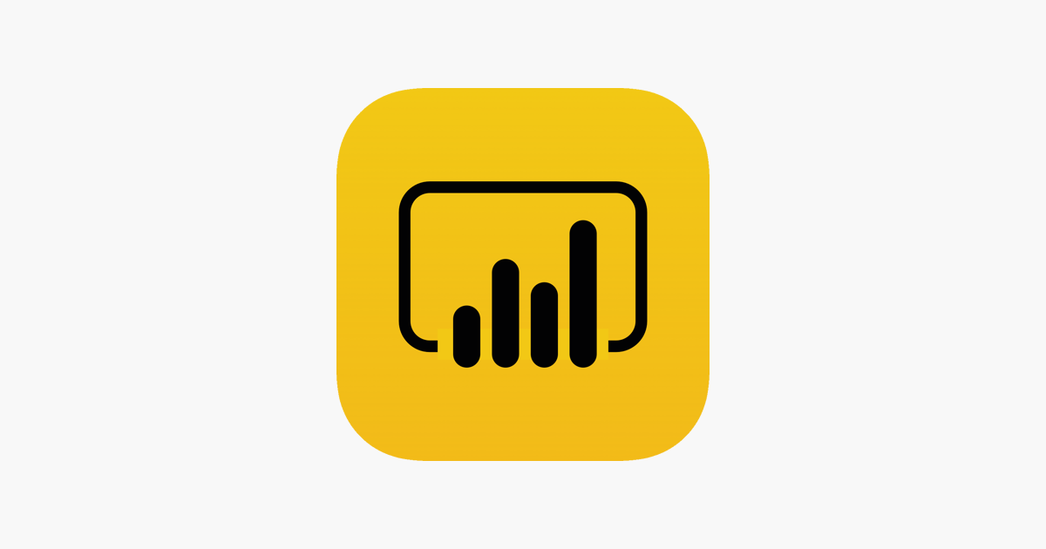


Global Spirits Manufacturer
Objective: Optimization of sales through classification & recommendations of products
Outcome: 10% increase(2M €) in spirits sales volume in France as a result of solution developed
Data Sources
Data Processing
Visualization
PoS data (Daily update)
Data cleaning
Data model
Analysis
Address normalization using regex
Build/refine the product catalogue
Connectors to ingest data from different sources
Defined data model
Storage in data lake and sql server
Python API to feed results to live dashboard
Segmentation model to classify stores in 10 categories
Ranking model to prioritise different products for sales recommendation
Dashboard Power BI
Promotions data
Socio-demographic data
Some extracts in Excel format
Private & Confidential

Slide 16

Insurance Fraud Detection
Objective: Prevent and detect the deceitful claims without affecting customer experience
Outcome: A million claims analysed on daily basis across top 100 insurance carriers across the world
Data Sources
Data Processing
Visualization
Policy and claims
Data cleaning
Data model
Analysis
Data anonymization
Phonetic model for name normalisation
Image data cleaning
Defined data model for data collection
Storage in SQL server
Model for image similarity and metadata analytics for images
Graph based model to create relationship between entities
Ranking model to score claims based on fraud probability
Subscription information
JS based frontend
Historical claims data
Deployment on self managed infrastructure on Azure
Private & Confidential

Slide 17


Leading European Retailer
Objective: User segmentation. Optimization of store assortment and marketing campaign analysis
Outcome: Personalised promo recommendations leading to 3% increase in promotion sales
Data Sources
Data Processing
Visualization
PoS data
Data cleaning
Data model
Analysis
Promotion data standardization
Normalized the product referential
Marketing data aggregation
Client association using online and offline usage
Data model to normalise PoS data
Data model for promotion and inventory data
User segmentation
SKU ranking to optimize the store assortment
Marketing campaign analysis using the SKU ranking and client segmentation
Dashboard data studio
Promotions data
Inventory data
Some extracts in Excel format
Private & Confidential

Slide 18
E-Commerce Agency
Objective: Product matching across competition for better marketing strategies
Outcome: 94% accuracy of matched products’ analysis for marketing and price optimization
Data Sources
Data Processing
Visualization
Category wise data
Data analysis
Data model
Analysis
Data exploration
Stop words removal
Lemmatization
Category wise data analysis
Product matching based on title and attributes
Ranking model to rank similar products within the category
Image similarity using computer vision
Product Similarity Model
Identify similar products in a product category from the e-commerce data
Dashboard data studio
Products data
Product attribute data
Some extracts in Excel format
Private & Confidential

Slide 19

Financial Services Provider
Objective: Churn analysis for the products and services being provided
Outcome: Identified churning rate and businesses susceptible to churning and recommendations on that
Data Sources
Data Processing
Visualization
Transactional data
Data analysis
Data model
Analysis
Data extraction from client database
Data exploration and transformation
Identification of churn susceptible business
Model to rank businesses based on risk of churn
Development of products and services recommendation engine
Churn prediction model
Recommendation analysis for products and services provided
Dashboard data studio
Products and services data
Business catalogue
Data visualization using Seaborn
Private & Confidential

Slide 20

AssetTech Financial Consultant
Objective: Analysis of the portfolios and build a leverage model
Outcome: Automated portfolio analysis for portfolios and credit management for leverage modelling
Data Sources
Data Processing
Visualization
Assets data
Data analysis
Data model
Results
Execution flow based on dependencies
Creation of base data
Relationships and dependencies between the Data
Processing and computing of new features based on the relationship with the base data
Interactive web app to manipulate the data analysis process
Summarized results after complete analysis
Interactive user access to choose the service
Freedom to run multiple simulations for different scenarios
Plotly dash
Portfolio data
Credit data
Data analysis
Private & Confidential

Slide 21

Financial Consultant
Objective: To develop a customized search engine with end to end pipeline for document indexing and search
Outcome: A search engine that facilitates the search for a particular information from a sea of documents
Data Sources
Data model
Results
User uploaded documents
Exploration
Development
Deployment
Exploration of the existing components of the solution
Tested and deployed the existing solution
Defined a product development roadmap
Developed user access control mechanism
Integrated Rest APIs
On the fly document document training and deployment
Developed and integrated the frontend
Containerized the solution
Deployed the solution on cloud environment where search could be performed seamlessly
Tested with the user data to search in the document report
Azure blob storage
HummingBird AI
PDF format documents
Private & Confidential

Slide 22
Private & Confidential

